Slide 1
Carryover Funds
Sponsors of Day Care Homes

Slide 2
Carryover Funds
Only permitted when using the Homes times Rate (HxR) option
Maximum carryover amount is 10% of anticipated earnings for the whole year.
Shown in column J of the Sponsor Earnings Report.
The report will track remaining carryover funds until entire amount has been used.
Sponsors must use the carryover funds early in the current fiscal year.

Slide 3
Sponsor Earning Reports
Sponsors of Day Care Homes

Slide 4
Purpose
Allow sponsors and state staff to:
Track administrative expenditures
Review and reconcile those administrative expenses against the approved budget
Determine if the administrative expenses claimed are authorized in the approved budget

Slide 5
Claim Reimbursements: Two Options
Option 1
Option 2
Lesser of (actual administrative expenses and HxR without going over total approved budget amount); or
Homes Times Rate (HxR)
Note: Sponsors can choose their payment method at renewal each year, and may switch only 1 time each year.

Slide 6
Lesser of Option

Slide 7
Claim Information – Lesser of
Column A contains the month/year of the claim
Column B contains the claim number for each month
0=orginal; 1=1st revision; 2=2nd revision, etc.)
Column C contains the date the claim was submitted

Slide 8
Claim Limitations – Lesser of
Column D contains the total number of homes claimed
Column E contains the HxR reimbursement amount
Column F contains the reported actual administrative expenses for that month

Slide 9
Earnings Status – Lesser of
Column G contains the Year-to-Date LOWEST amount between HxR and actual administrative expenses
Column H contains the total YTD payments through the month’s claim
Column I contains the amount of administrative earnings for the month. This amount is calculated by subtracting Column H from Column G

Slide 10
Earning Status – Lesser of
Column J contains the total meal earnings for the month
Column K contains the total adjusted amount for the month (between revisions of the same month). Amount will appear on report in next month to be paid out. Adjusted amounts will also appear in the next payment.
Column L contains the total reimbursement amount for the month

Slide 12
Actual Administrative Expenses < HxR
Not using enough available funds.
Sponsor should access their budget to make sure they are claiming all approved/allowable expenses (increase costs)

Slide 13
Actual Administrative Expenses > HxR
Any excess administrative expenses will be carried over to subsequent months in the same fiscal year
If the actual expenses are significantly higher, look carefully at any administrative expenses before they are incurred
Check to see if other funding sources are available to offset any administrative expenses over the approved budget amount

Slide 14
Homes times Rate (HxR)

Slide 15
Claim Information – HxR
Column A → D are the same as those on Lesser of report
Column E contains the reported actual administrative expenses for that month
Column F contains the HxR
Column G contains the monthly meal earnings
Column H is the monthly total adjustment (between revisions of the same month)
Column I contains the monthly total reimbursement
Column J contains any carryover expended that month

Slide 16
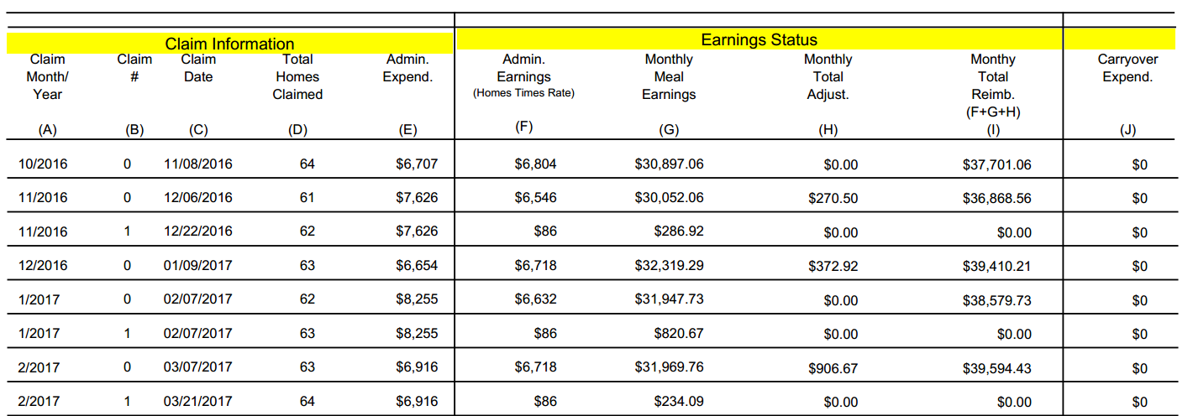

Slide 17
Actual Administrative Expenses < HxR
Not using enough available funds. Sponsor should access their budget to make sure they are claiming all approved/allowable expenses (increase costs)
If costs cannot be increased, sponsor needs to monitor budget to see if HxR amount continues to be more than actual administrative expenses. If so, sponsor should contact the assigned Financial Specialist to discuss switching to Lesser of option.

Slide 18
Actual Administrative Expenses > HxR
If the actual administrative expenses are significantly higher, carefully review administrative expenses before they are incurred. If the costs are still significantly higher after 2 or 3 consecutive months, sponsor should consult with their assigned Financial Specialist
Check to see if other funding sources are available to offset excess administrative expenses over the approved budget amount

Slide 19
Shared Rules
Sponsor Earnings Reports should be reviewed monthly
All administrative expenses must be allowable, incurred and documented
Make sure the claimed administrative expenses are actual and documented for each month.
No two consecutive months should be exactly the same

Slide 20
More Shared Rules
Compare the actual administrative expenses to HxR amount
If the amounts are the same, either the actual administrative expenses were not reported, or costs were reported up to the HxR
Any excess administrative expenses will be carried over to subsequent months in the same fiscal year

Slide 21
Claim Revisions
It is the sponsor’s responsibility to submit accurate claims each month
Administrative expenses revisions should be done only when necessary
Acceptable reasons for administrative expenses revisions:
Forgot to include a permissible expense
Waited on supporting documentation for a particular expense

Slide 22
YTD Remaining Budget Amount
Check the remaining budget amount at the top of the report to make sure the YTD reimbursement leaves an appropriate amount for the remainder of the fiscal year. If the remaining amount is too high or low, a budget amendment may be necessary. Contact your assigned Financial Specialist for technical assistance.
Remember that the YTD reimbursement for administrative expenses cannot exceed the amount approved in the budget

Slide 23
Maximizing Reimbursements
To maximize and effectively use administrative reimbursements, the actual administrative expenses should be close to the HxR amount.

Slide 24
Thank you!

